Slide 1

Software Design and architecture (SE322) gg
Week 09,10
Said Nabi
said.nabi@giki.edu.pk
Faculty of Computer Science and engineering
Gik Institute Topi, Swabi

Slide 2
List of Topics
Design patterns, Composing Objects Principle, Law of Demeter, Anti Patterns or Code Smells

Slide 3







State Design Pattern
Object
fun3()
State 1
State 2
State 3
fun1()
fun2()
fun3()

Slide 4




Vending Machine example
Enough Coins
Insert Coin
[total==price]
Total
Idle
Display Enough
Coins
Insert Coin
Total
Total=0
[total==price]
Dispense Product
Display Total
Insert Coin
[total<price]
Insert more coins
Cancel
Total= 0;
Eject Coins

Slide 5
UML Diagram
VendingMachine
- currentState: VendingState - noCoinState: VendingState - hasCoinState: VendingState - dispenseState: VendingState - soldOutState: VendingState - itemCount: int
+insertCoin(coin: int) +selectItem() +dispense() +returnCoin() +refill(quantity: int) +getXState(): VendingState +getItemCount(), ...
<<Interface>> VendingState
+insertCoin(...) +selectItem(...) +dispense(...)
NoCoinState
Implements VS
HasCoinState
Implements VS
DispenseState
Implements VS
SoldOutState
Implements VS

Slide 6
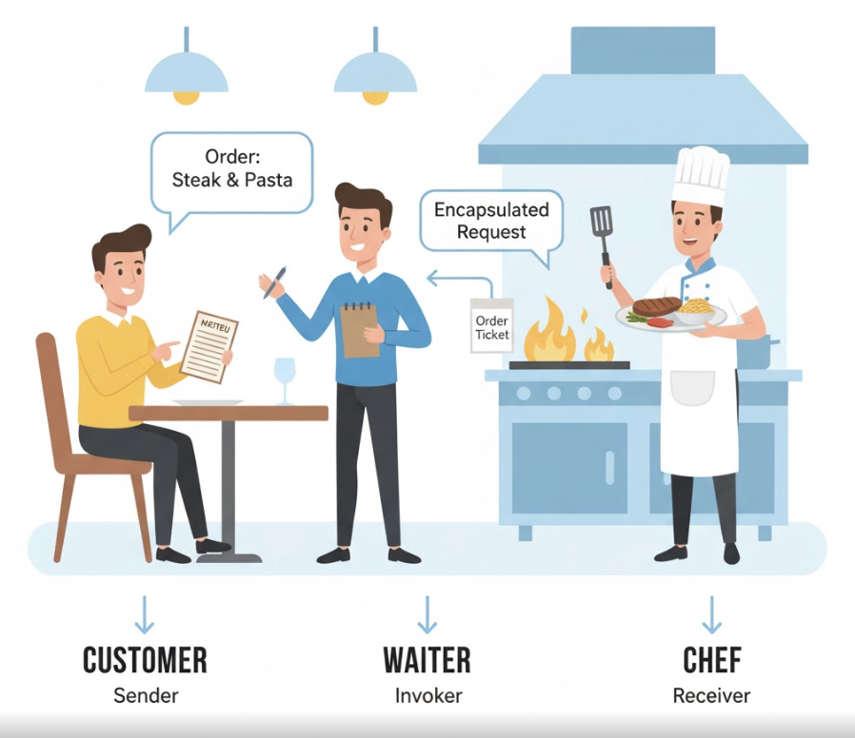

Slide 7
Application of Command pattern
Executed Commands
E
D
C
B
A
Unexecuted Commands

Slide 8
Redo/Undo
Executed Commands
 |  | D | C | B | A
Unexecuted Commands
 |  |  |  |  | E

Slide 9
Redo/Undo
Executed Commands
 |  |  | C | B | A
Unexecuted Commands
 |  |  |  | D | E

Slide 10
Redo/Undo
Executed Commands
Unexecuted Commands
 | A | B | C | D | E

Slide 11
Redo/Undo
Executed Commands
 | E | D | C | B | A
Unexecuted Commands

Slide 12
Command Design Pattern
In real-world software systems, actions are often requested by one part of a program but carried out by another.
Without the command pattern, these components would be tightly coupled
  — meaning one part must know the exact details of how another part works. This makes software harder to maintain, extend, and modify.
The Command Pattern solves this problem by decoupling the sender and receiver of a request. It turns each request into an object, allowing you to manipulate, store, queue, or undo it easily.
Here’s why it’s needed:
  Decoupling – The object that issues a request doesn’t need to know how the request will be handled. This improves flexibility and maintainability.
  Undo/Redo Functionality – In text editors, graphics programs, or IDEs, users can undo and redo actions easily because each action is represented as a command object.
  Queuing and Scheduling – Commands can be queued and executed later, useful in task schedulers, batch processors, or job queues.
  Logging and Recovery – Commands can be logged for auditing or replayed after a crash to restore the system’s state.
  Macro Commands – Multiple commands can be grouped and executed as a single complex operation.

Slide 13
UML Diagram
Invoker
- command: Command
+ setCommand() + executeCommand() + undoCommand()
<<Interface>> Command
+ execute() + unexecute()
ConcreteCommand
- receiver: Receiver
+ execute() + unexecute()
Receiver
+ action() + undoAction()

Slide 14


Slide 15
Observer Design Pattern
The Observer Design Pattern is a pattern where one main object, called the subject, keeps a list of other objects known as observers.
Whenever something changes inside the subject, it automatically notifies all its observers about the change.
In this pattern, there is usually a Subject class that stores a list of observers.
There is also an Observer interface that defines a method (like update()) which is called whenever the subject’s state changes.
Sometimes, the subject can have subclasses, and those subclasses can also act as observers.
Together, these parts form a link where the subject sends updates, and the observers receive them automatically.

Slide 16
Observer Design Pattern Cont…
Imagine you subscribe to a blog and want to get a notification whenever the blog is updated.
In this example, there are two main parts:
  The Subject → the Blog
  The Observer → the Subscriber
To create a connection between them, the subscriber first subscribes to the blog. After that, whenever the blog is updated, it will automatically notify all subscribers about the change.
The notify() function makes sure that every subscriber always has the latest information.
This function is only called when something actually changes in the blog.
When that happens, the blog calls the update() method for each subscriber.
Subscribers can then use getState() to check what changed.
If a subscriber doesn’t want updates anymore, they can unsubscribe(),
and the blog will remove them from its list of observers.

Slide 17
UML Diagram
<<Interface>> Subject
+ registerObserver(Observer): void + unregisterObserver(Observer): void + notify(): void
<<Interface>> Observer
+ update(): void
Observers
0...*
Blog
-state: String
+getState(): String
Subscriber
+ update(): void {}

Slide 18
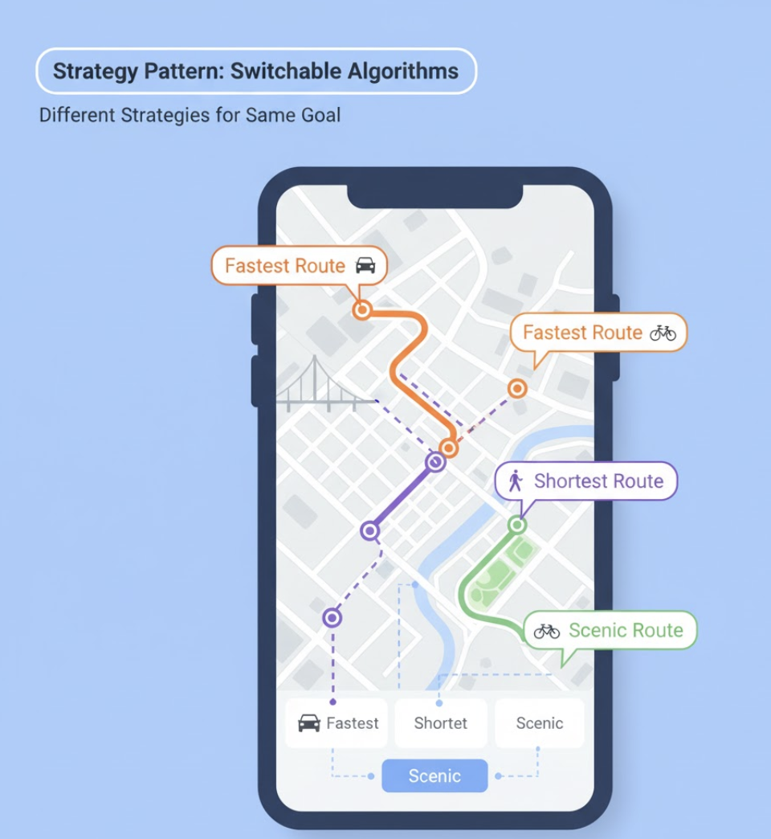
Strategy Design Pattern
Think about a navigation app like Google Maps.
You can select different route-finding strategies:
  Fastest route
  Shortest route
  Walking route
All these options lead to the same goal (getting to your destination),
but they use different strategies to achieve it.

Slide 19
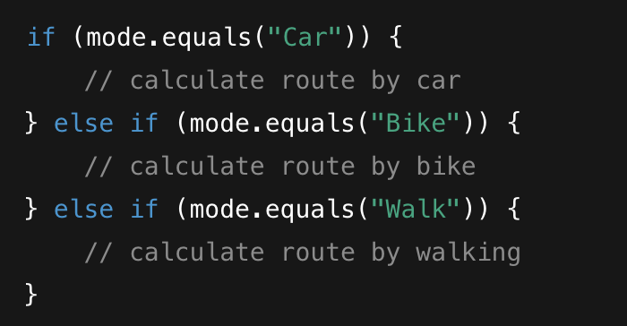
Strategy Design Pattern Cont…
The Strategy Design Pattern is a behavioral pattern that allows you to define multiple algorithms (ways of doing something), encapsulate each one in its own class, and switch between them easily at runtime — without changing the code that uses them.
It lets you change the behavior of an object dynamically by swapping its algorithm.
Without Strategy Pattern, you often see code like this:

Slide 20
UML Diagram
PaymentProcessor
- strategy: PaymentStrategy
+ setStrategy(Strategy): void + executeStrategy(): void
<<Interface>> PaymentStrategy
+ pay(int amount): void
ConcreteStrategyC
+ pay(int amount): void
ConcreteStrategyA
+ pay(int amount): void
ConcreteStrategyA
+ pay(int amount): void

Slide 21
Composing Objects Principle
  Tight Coupling is a frequent issue in system design, where classes depend too heavily on each other. To manage this, design principles such as generalization, abstraction, and polymorphism—the foundation of many design patterns—are used to introduce indirection and reduce dependencies.
  While inheritance promotes code reuse, it also creates strong coupling between super classes and subclasses, meaning changes in one can easily affect the other. Deep inheritance hierarchies worsen this by exposing attributes and behaviors across multiple levels.
  The Composing Objects Principle addresses this by encouraging code reuse through aggregation (composition) instead of inheritance.
  Using aggregation and delegation allows objects to collaborate without being tightly bound, resulting in more flexible, maintainable, and loosely coupled systems.

Slide 22
Composing Objects Principle Cont…
The Composing Objects Principle emphasizes building complex behavior by combining smaller, independent objects rather than relying solely on inheritance. This approach allows classes to work together at an “arm’s-length” relationship, where they remain independent but can collaborate by delegating tasks to one another.
Design patterns such as the Composite and Decorator patterns apply this principle — they combine concrete classes at runtime to form new, more complex behaviors. By composing objects, systems gain greater flexibility, as behavior can be changed dynamically at runtime without modifying class hierarchies. This contrasts with inheritance, where behaviors are fixed at compile-time and tightly couple subclasses to superclasses.
However, composition has its drawback — since it doesn’t inherit code, each class must implement its own behavior, which may lead to code repetition.

Slide 23
Principle of Least Knowledge and the Law of Demeter
The Principle of Least Knowledge suggests that a class should know and interact with as few other classes as possible. This helps reduce complexity — if each class only depends on a small number of others, the system becomes easier to maintain and modify.
This idea is closely related to the Law of Demeter, which provides rules for how objects should communicate. Rather than focusing on structure, it defines how method calls should be made to keep classes loosely coupled.
According to the Law of Demeter, a method M of class should only call methods that belong to:
  The same class (itself).
  Objects passed as parameters to M.
  Objects created or instantiated inside M.
  Objects referenced by instance variables of the class.

Slide 24
Details about each rule:
Rule 1: A method can call any other method in the same class.
Rule 2: A method can call methods on its parameters, since they’re local to the method.
Rule 3: A method can call methods on objects it creates within itself.
Rule 4: A method can also call methods of objects stored in instance variables of its class
Following the Law of Demeter helps:
  Reduce coupling between classes.
  Increase maintainability and reusability.
  Prevent errors from spreading across unrelated parts of the system.
  However, it also means more design effort. Strictly following it may require extra time and sometimes isn’t practical due to real-world constraints. In some cases, a small amount of coupling is acceptable, depending on the project’s complexity and time limits.

Slide 25
Anti Patterns and Code Smells:
No matter how well code is written, changes are always necessary over time. Refactoring is the process of improving the internal structure of code without altering its external behavior. It involves making small, incremental improvements and testing frequently to ensure functionality remains the same.
Refactoring is best done while adding new features, not after the project is finished, as this makes future updates easier and more efficient.
Sometimes, recurring signs of poor code structure appear — these are called anti-patterns or code smells. Martin Fowler’s book Refactoring identifies many such code smells and provides strategies to “clean up” and improve them. We will explore several of these code smells and how to fix them.

Slide 26
Comments:
One common sign of poor code quality is the misuse of comments—either having too few or too many. Without sufficient comments, the code becomes difficult to understand or maintain, especially after some time has passed. However, excessive commenting can lead to inconsistencies as the code evolves and often serves to hide underlying design flaws.
When developers use comments as reminders or to explain how changes in one method affect another, it usually indicates tight coupling or poor structure.
While comments are essential for documenting System, explaining complex algorithms, and clarifying design decisions, they must be clear, concise, and purposeful. Maintaining a balanced approach ensures that comments support readability rather than masking bad code practices.

Slide 27
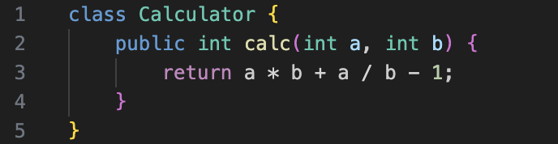
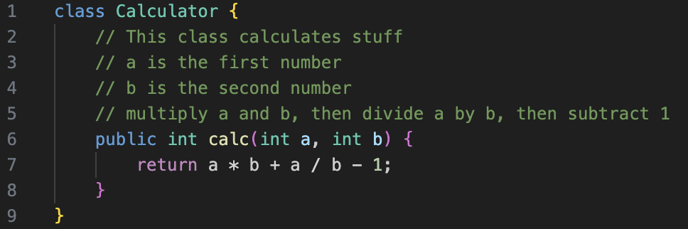
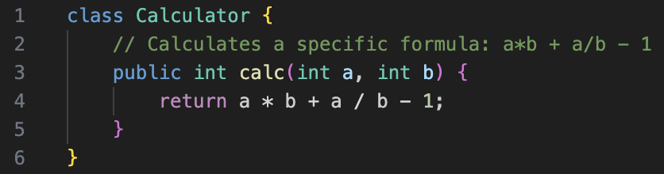
Example:

Slide 28
Duplicate Code:
Duplicated code is a common code smell that occurs when similar blocks of code appear in multiple places with only slight variations. This becomes problematic because any change or fix—such as adding new functionality, updating an algorithm, or correcting a bug—must be made in several locations, increasing the chance of errors or missed updates.
Maintaining duplicate logic also makes the system harder to manage and extend over time. A cleaner approach is to centralize shared behavior so that updates occur in one place only.
This aligns with the D.R.Y. (Don’t Repeat Yourself) principle, which emphasizes reducing redundancy and writing code that performs tasks efficiently with minimal duplication, improving both maintainability and clarity.

Slide 29
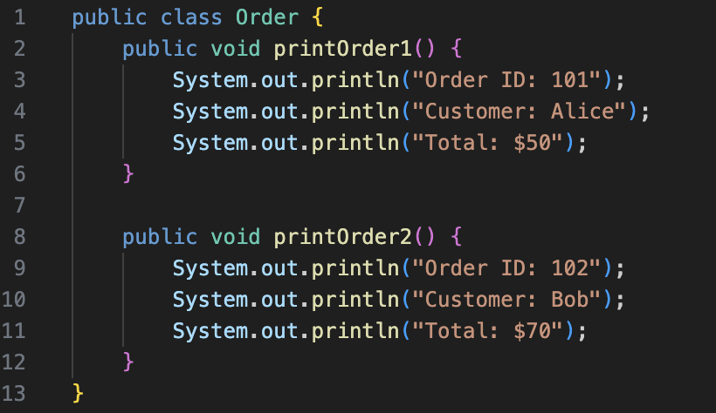
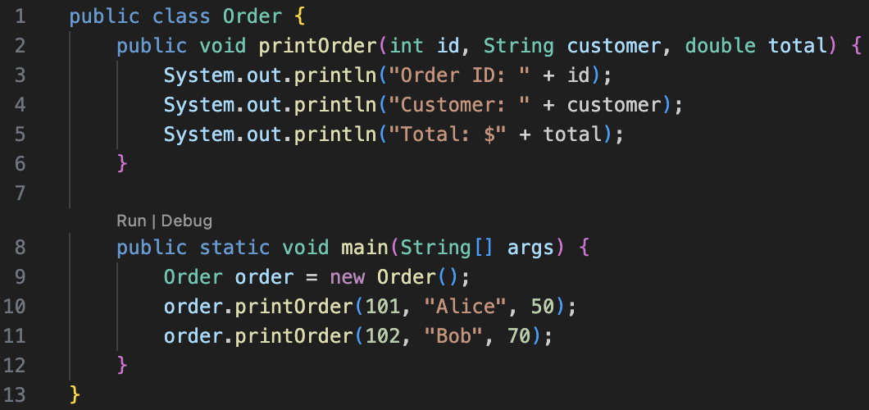
Example:

Slide 30
Long Method:
The Long Method anti-pattern occurs when a method becomes too lengthy or complex, often trying to handle multiple responsibilities at once. Long methods can make code harder to read, test, and maintain, as they usually signal that the logic should be divided into smaller, focused parts.
However, determining when a method is “too long” can be subjective, since length doesn’t always equal complexity — for instance, methods that build user interfaces may naturally be longer but still cohesive.
The acceptability of method length can also depend on the programming language and its conventions; for example, Java typically uses short, concise methods averaging about 15 lines.
In general, context matters, but when a method grows too long, it often indicates a need for refactoring to improve clarity and maintainability.

Slide 31
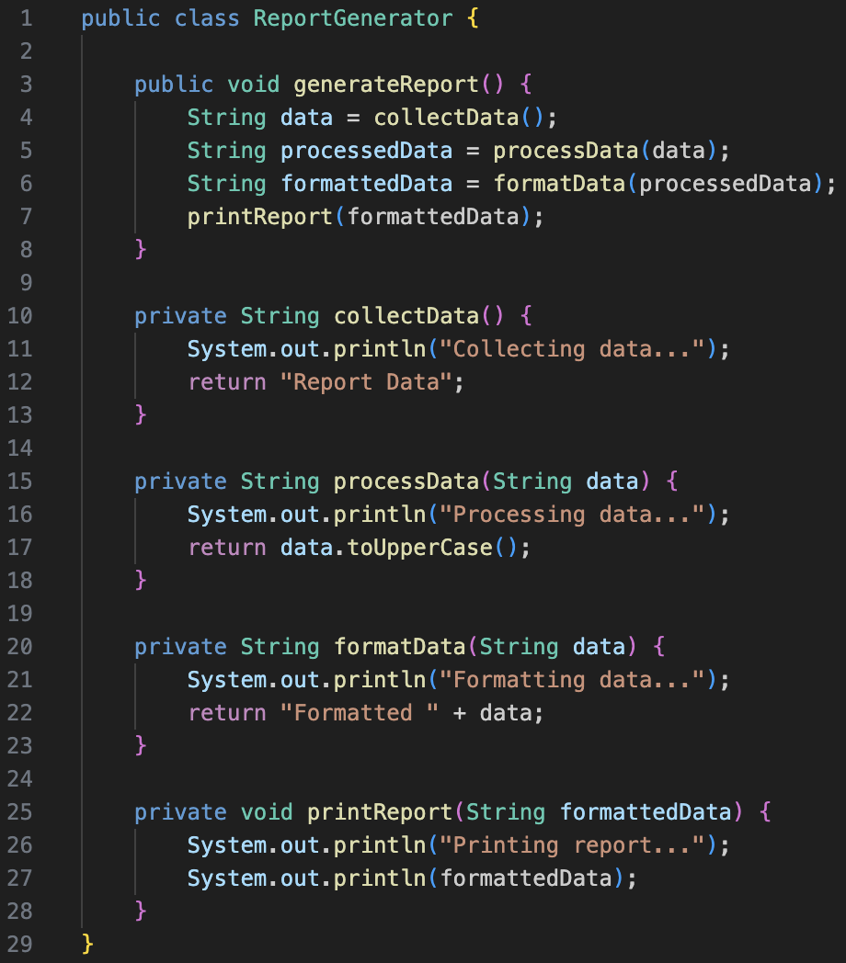
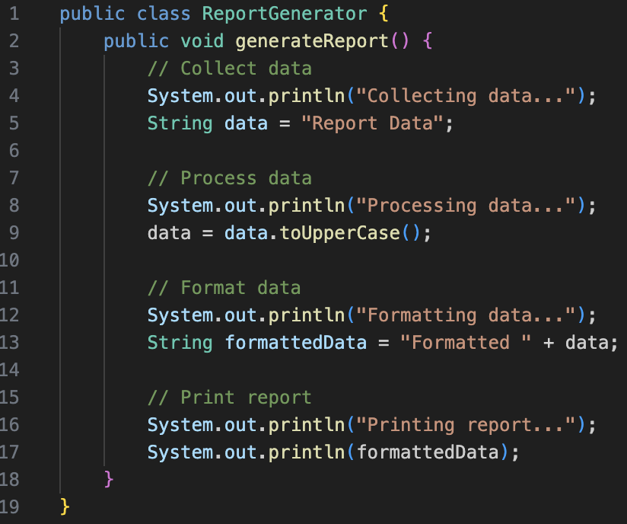
Example:

Slide 32
Long Class:
The Large Class anti-pattern occurs when a class becomes too big and overloaded with responsibilities, much like the Long Method problem. Such classes—often called God Classes, Blob Classes, or Black Hole Classes—start out normal but gradually expand as more features and logic are added. Over time, they become difficult to understand, maintain, and modify.
Large classes often rely heavily on comments to explain where different functionalities are located, which itself signals poor design.
To prevent this, each class should have a clear, focused purpose and handle only one main responsibility.
Detecting and addressing this issue early is crucial, as refactoring a large class later can be complex and time-consuming.

Slide 33
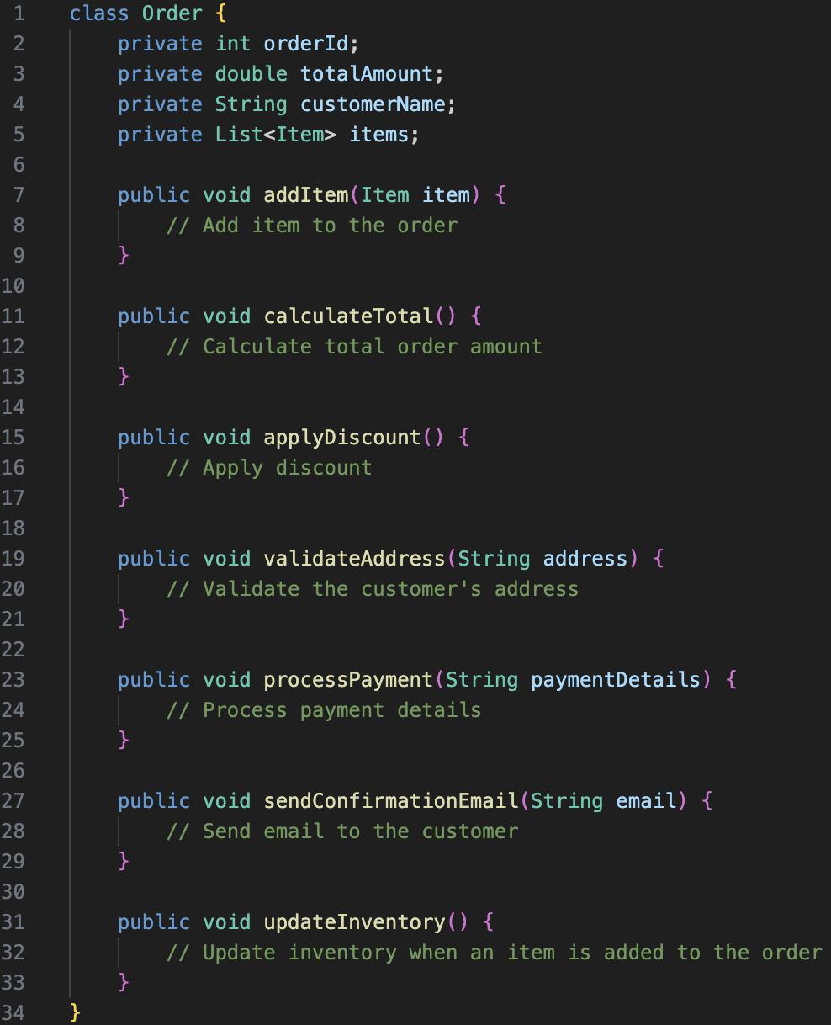
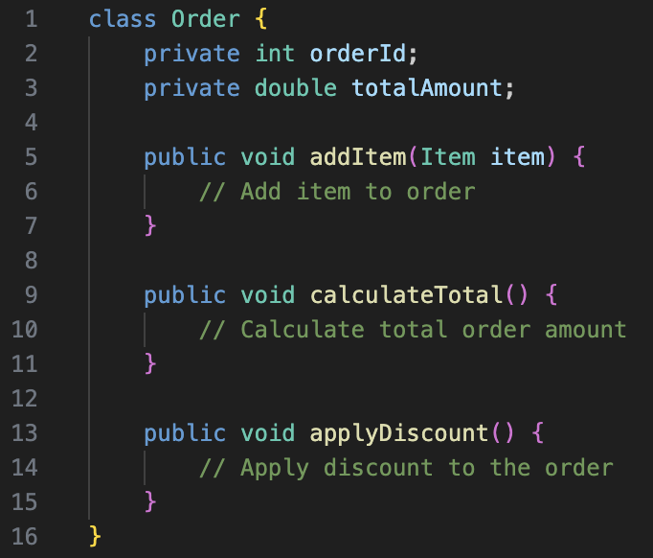
Example:

Slide 34
Data Clumps:
The Data Clumps anti-pattern occurs when the same group of related data items (like car make, model, and year) repeatedly appear together as method parameters or instance variables.
This repetition often suggests that these values should be encapsulated into a single class. For instance, instead of passing make, model, and year separately to multiple methods, they can be grouped into a Car class. This not only simplifies method signatures but also improves readability and reusability.
However, while refactoring data clumps, it’s important to ensure the new class isn’t just a data holder — it should include relevant behaviors or logic, such as methods to display or update car details, to maintain proper object-oriented design.

Slide 35
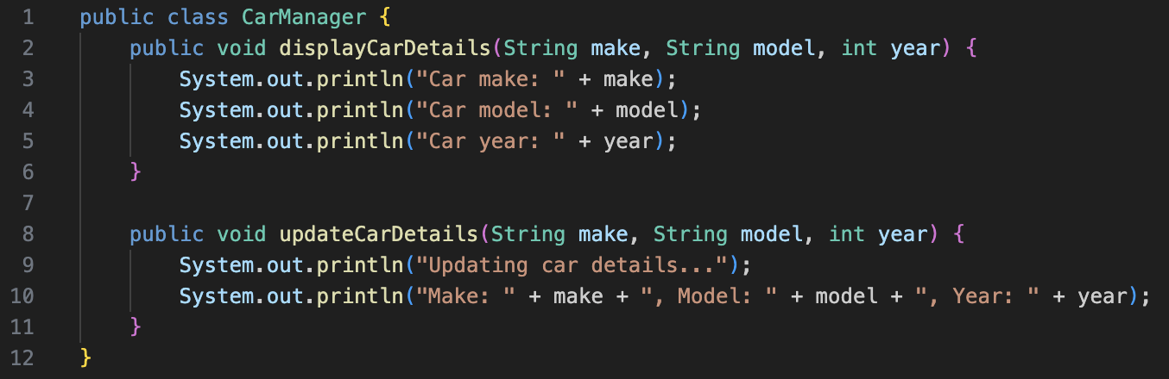
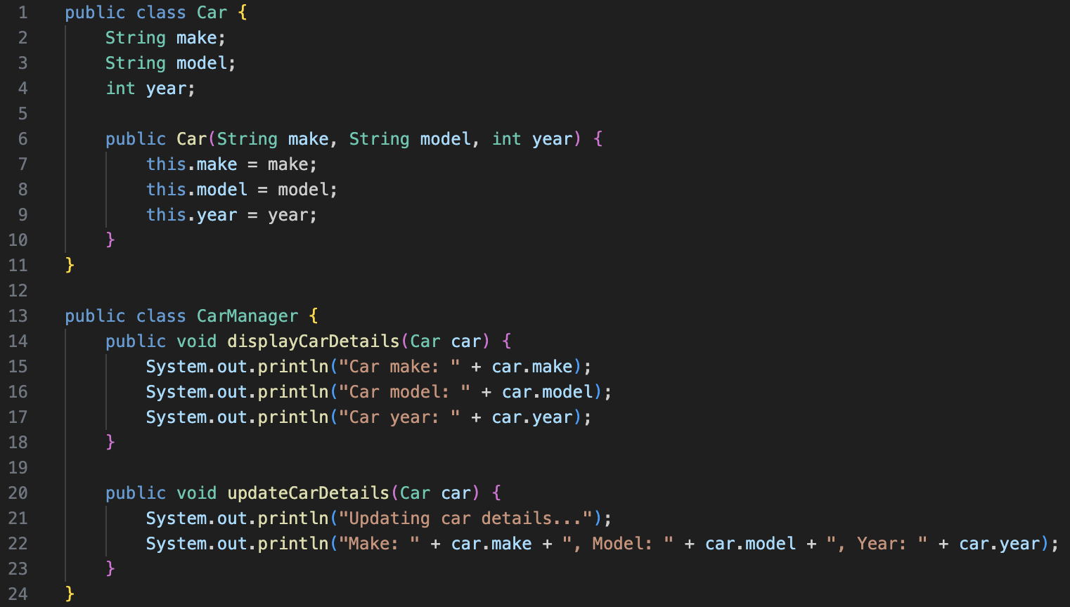
Data Clumps:

Slide 36
Thank You☺

